Slide 1
Abstracts

Slide 2
What is an Abstract
Short summary of your paper
Serves multiple purposes:
Get the essence of the paper so the audience can decide if they want to read your paper
Prepares the reader for the organization of your paper
Helps the reader remember the key points

Slide 3
Content Matters
In search engines and databases, abstracts and titles are used to search for papers
Your abstract should be intelligible on its own, without reading the entire paper.
No citations – the abstract should describe what you have studied and your own results

Slide 4
Sample organizations
1. One sentence to describe topic
2. 1-2 sentences describing past literature/gap
3. Details on methods and analyses
4. Major findings and significance/applications

Slide 5
Sample organizations
1. One sentence to describe topic
2. 1-2 sentences describing past literature/gap
3. Details on methods and analyses
4. Major findings and significance/applications

Slide 6
Sample organizations
1. One sentence to describe topic and literature
2. Details on methods and results
3. Significance/applications

Slide 7
Sample organizations
1. One sentence to describe topic and literature
2. Details on methods and results
3. Significance/applications

Slide 8
Examples
As the popularity of online education continues to rise, many colleges and universities are interested in how to best deliver course content for online learners. This study explores the ways in which taking courses through an online medium impacts student engagement, utilizing data from the National Survey of Student Engagement. Data was analyzed using a series of ordinary least squares regression models, also controlling for relevant student and institutional characteristics. The results indicated numerous significant relationships between taking online courses and student engagement for both first-year students and seniors. Those students taking greater numbers of online courses were more likely to engage in quantitative reasoning. However, they were less likely to engage in collaborative learning, student-faculty interactions, and discussions with diverse others, compared to their more traditional classroom counterparts. The students with greater numbers of online courses also reported less exposure to effective teaching practices and lower quality of interactions. The relationship between these engagement indicators and the percentage of classes taken online suggests that an online environment might benefit certain types of engagement, but may also be somewhat of a deterrent to others. Institutions should consider these findings when designing online course content, and encourage faculty to contemplate ways of encouraging student engagement across a variety of delivery types.

Slide 9
Examples
Importance and Aim
Methods - Analyses
As the popularity of online education continues to rise, many colleges and universities are interested in how to best deliver course content for online learners. This study explores the ways in which taking courses through an online medium impacts student engagement, utilizing data from the National Survey of Student Engagement. Data was analyzed using a series of ordinary least squares regression models, also controlling for relevant student and institutional characteristics. The results indicated numerous significant relationships between taking online courses and student engagement for both first-year students and seniors. Those students taking greater numbers of online courses were more likely to engage in quantitative reasoning. However, they were less likely to engage in collaborative learning, student-faculty interactions, and discussions with diverse others, compared to their more traditional classroom counterparts. The students with greater numbers of online courses also reported less exposure to effective teaching practices and lower quality of interactions. The relationship between these engagement indicators and the percentage of classes taken online suggests that an online environment might benefit certain types of engagement, but may also be somewhat of a deterrent to others. Institutions should consider these findings when designing online course content, and encourage faculty to contemplate ways of encouraging student engagement across a variety of delivery types.
Discussion – Moves 1 and 4
Results

Slide 10
Examples
Homeless youth are an understudied and stigmatized group. In their daily lives, these youth confront negative social perceptions and harrowing circumstances related to survival, which may present challenges to the construction of a meaningful, coherent identity. Using the theoretical notion of narrative engagement (Hammack & Cohler, 2009), this study explores how youth experiencing homelessness make meaning of their lived experiences and engage with dominant discourses about homelessness that stigmatize and devalue them. A narrative analysis of 4 case studies, drawn from in-depth life story interviews with 11 unhoused youth in the United States, suggests that despite experience of struggle and loss, participants demonstrated the ability to (a) resist contamination through the construction of redemptive narratives, grounded in agency and resilience; and (b) resist dominant narratives about homelessness by attributing their circumstances to external causes and by critiquing institutions and figures perceived as holding power. In doing so, participants refused to adopt a “criminal” or “client” master narrative of homeless identity, instead affirming the value and worth of their knowledge, experiences, and identities. This study reveals the active agency of homeless youth to construct counternarratives in which they may restory their identities to find resilience in the margins.

Slide 11
Examples
Importance and aims
Results
Methods
Homeless youth are an understudied and stigmatized group. In their daily lives, these youth confront negative social perceptions and harrowing circumstances related to survival, which may present challenges to the construction of a meaningful, coherent identity. Using the theoretical notion of narrative engagement (Hammack & Cohler, 2009), this study explores how youth experiencing homelessness make meaning of their lived experiences and engage with dominant discourses about homelessness that stigmatize and devalue them. A narrative analysis of 4 case studies, drawn from in-depth life story interviews with 11 unhoused youth in the United States, suggests that despite experience of struggle and loss, participants demonstrated the ability to (a) resist contamination through the construction of redemptive narratives, grounded in agency and resilience; and (b) resist dominant narratives about homelessness by attributing their circumstances to external causes and by critiquing institutions and figures perceived as holding power. In doing so, participants refused to adopt a “criminal” or “client” master narrative of homeless identity, instead affirming the value and worth of their knowledge, experiences, and identities. This study reveals the active agency of homeless youth to construct counternarratives in which they may restory their identities to find resilience in the margins.
Discussion - summary

Slide 12
Examples
The authors designed a qualitative, multiple case study that employed the photovoice method to explore how enculturation is experienced by three Chinese adolescents living with their families in a nonethnically dense cultural community. A total of 18 one-on-one interviews were conducted with three youth and their parents. Photos were also used as elicitation tools to understand the meaning of enculturation for each individual. Case descriptions of each adolescent are presented, followed by five cross-case themes: (a) SelfIdentifying as Chinese, (b) Parental Strictness, (c) Multiple Groups of Comparison, (d) (Not) Having a Chinese Community, and (e) Messages to Excel. The findings provide a descriptive understanding of how adolescent enculturation is shaped by the family, community, and their intersections. Implications for research and practice, such as the continued need to understand enculturation as a dynamic phenomenon and process, are presented.

Slide 13
Group work
Video:https://www.ted.com/talks/li_huei_tsai_could_we_treat_alzheimer_s_with_light_and_sound/transcript?language=en
The transcript for the video is also provided online if you need it
1. Use the contents of the video to write an abstract for the study described (Maximum 150 words)
2. Prepare a short ppt presentation or a simple poster based on this talk (with all IMRD sections)

Slide 14
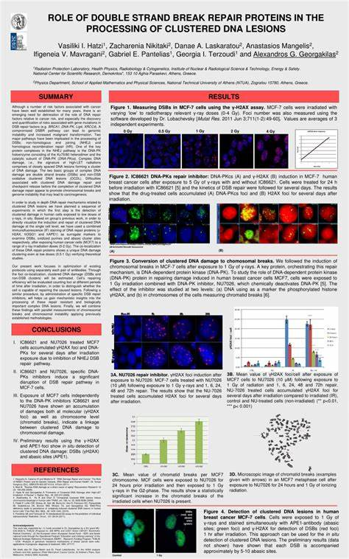
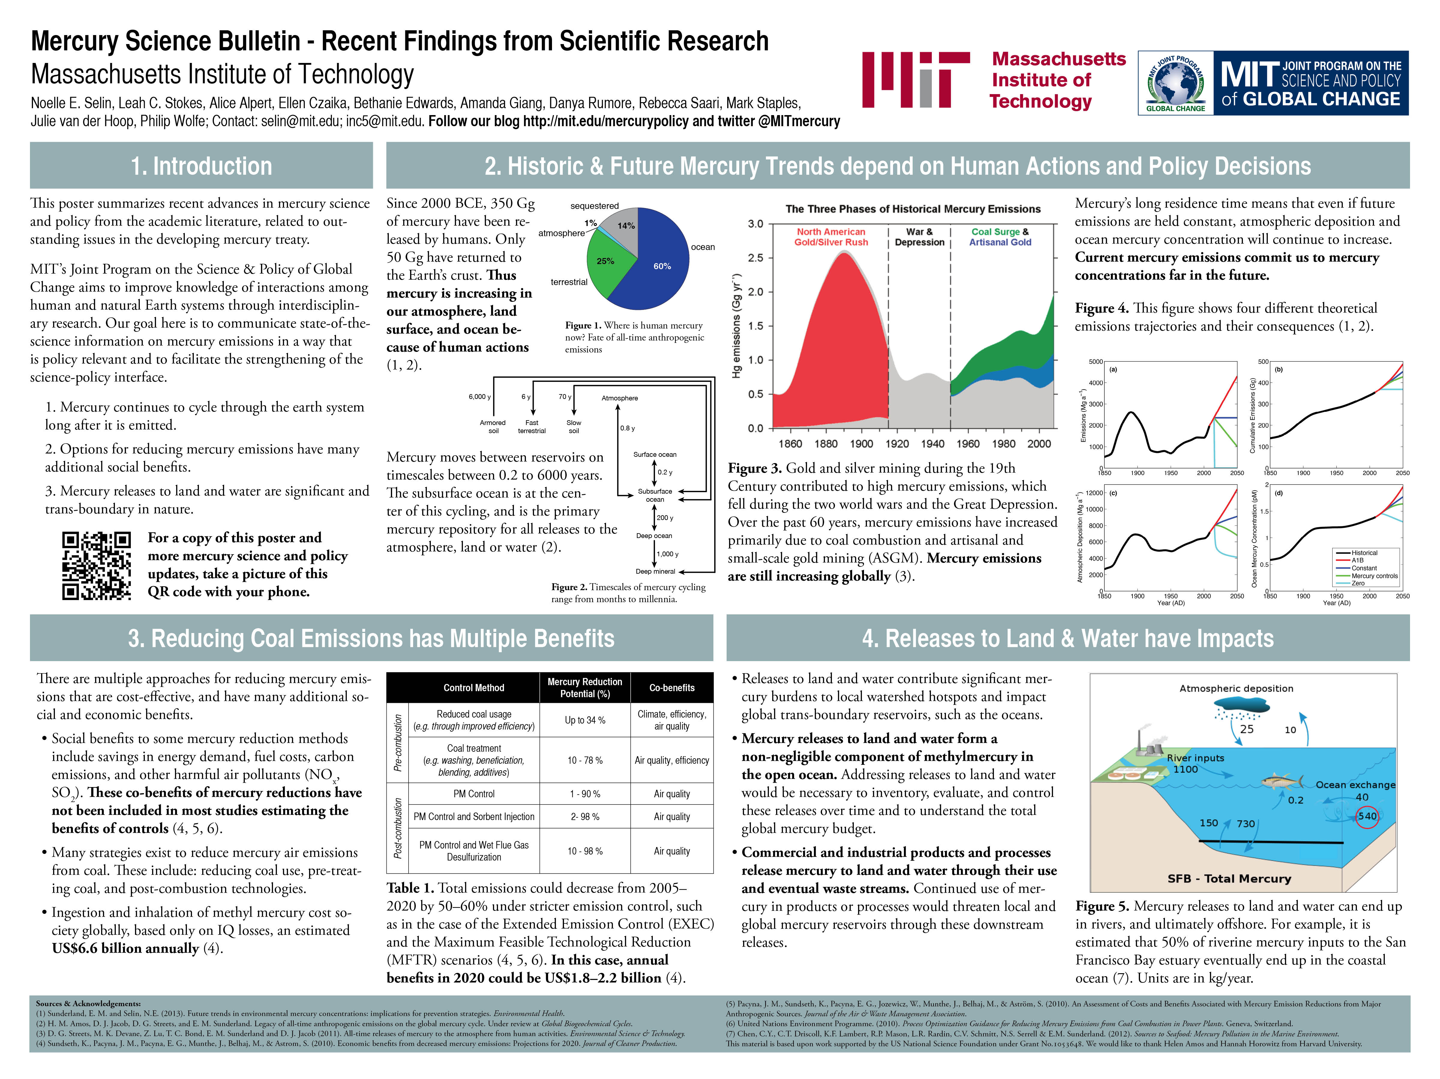

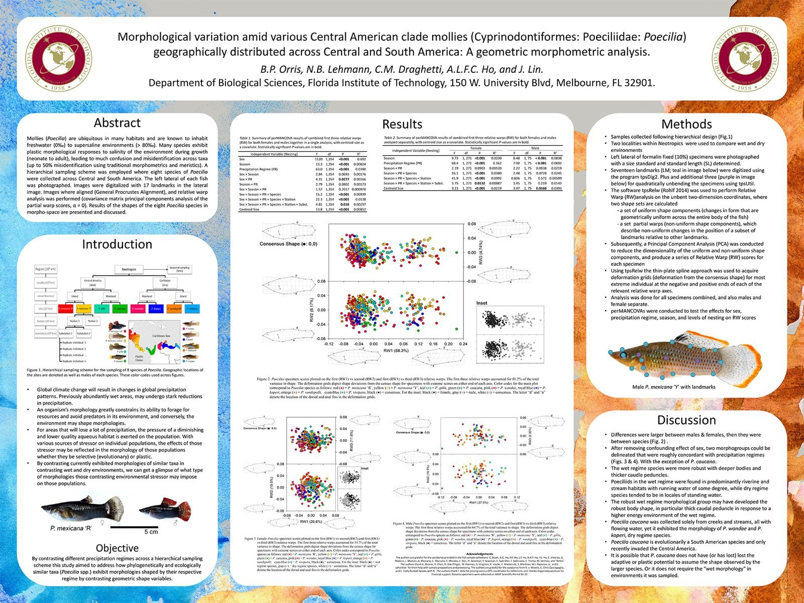
Poster Examples

Slide 15
Final Presentations
Your final presentation will start from week 13 until the end of term. Sign up for the time slot that you prefer next week (first come first serve)
Topics include any paper given in the other presentations during the class. However:
1. You cannot present a paper that is done in your group
2. You and your group members must choose different papers
Remember your audience (me)!

Slide 16
Final Presentations
After you sign up, you will need to let me know which paper you are going to use for the presentation
Final presentations will be a little more difficult: You have only 5 minutes to describe the entire paper (treat this as a poster presentation in a conference)
Keep in mind that because of setup and technical issues, the time may not be perfect. Be ready for your time slot to be pushed later. (If this is an issue, try to be one of the first presenters for that day.)

